Slide 1
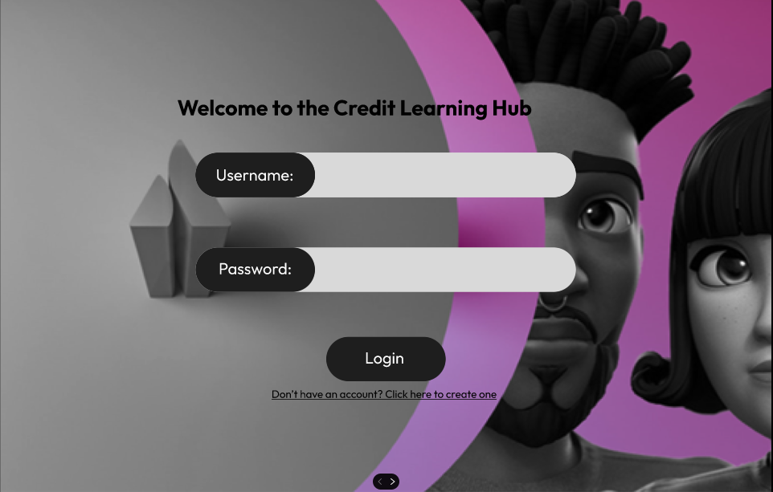
Joey
Joey
***********
*************

Slide 2

Joey
Joey
Joey
********
*************
********
*************

Slide 3
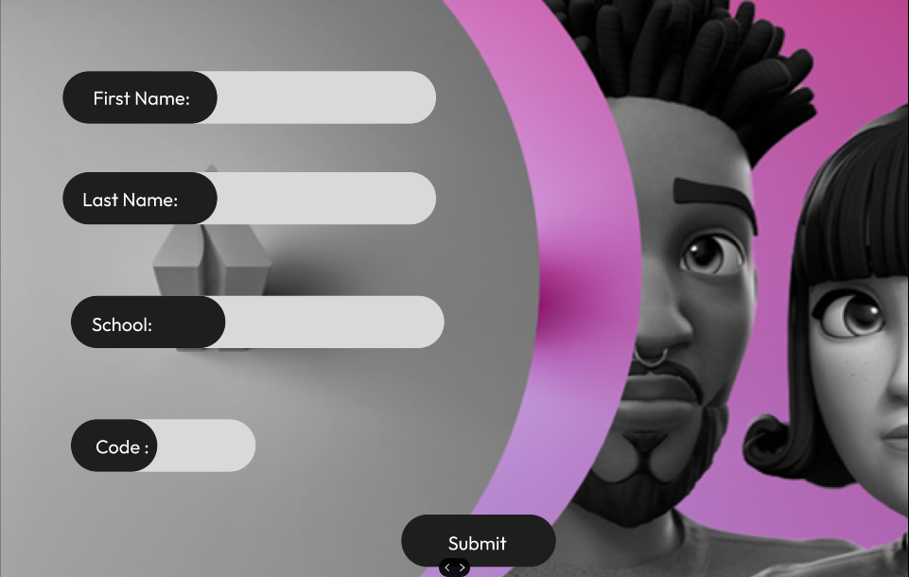
Joey
Joey
Carson
Carson
Alabama State University
Alabama State University
2hvBj/

Slide 4


Slide 5


Slide 6




Learning Hub
Christina/Instructor
Hello Joey!
In this learning hub, you will play games that simulate real-life scenarios to help you learn about credit and more. Upon completion, you can opt to take practice tests to gain points for the leaderboard, where the top ten scholars will get incentives at the end of the month.
Raudy/Instructor
What’s more is that we offer a diverse set of scenarios and puzzles to teach you an extensive amount of information from the basics level to the advanced level. Furthermore, you can take certification test as soon as you complete all you lessons to earn a Credit Academy certification.
Let’s Get Started

Slide 7



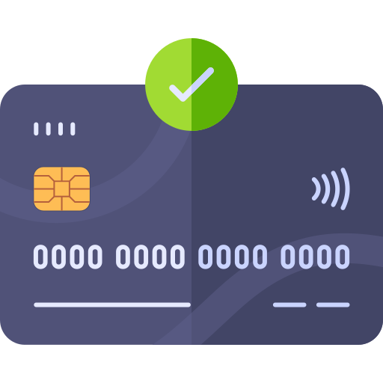

Scenario 1: Kindly drag and drop to see how a good credit score and a poor credit score can affect the purchasing price of a house. Play around with the movable credit cards and compare the purchasing prices you get:
Credit Card(760) Credit Card (550)
Input Card
Input Card

Slide 8
Scenario 1: Kindly drag and drop to see how a good credit score and a poor credit score can affect the purchasing price of a house. Play around with the movable credit cards and compare the purchasing prices you get:
Credit Card
Credit Card
Input Card
Input Card

Slide 9
Scenario 1: Kindly drag and drop to see how a good credit score and a poor credit score can affect the purchasing price of a house. Play around with the movable credit cards and compare the purchasing prices you get:
Credit Card
Credit Card
Input Card
Input Card

Slide 10
Scenario 1: Kindly drag and drop to see how a good credit score and a poor credit score can affect the purchasing price of a house. Play around with the movable credit cards and compare the purchasing prices you get:
Credit Card
Credit Card
Input Card
Input Card

Slide 11
Scenario 1: Kindly drag and drop to see how a good credit score and a poor credit score can affect the purchasing price of a house. Play around with the movable credit cards and compare the purchasing prices you get:
Credit Card
Credit Card
Input Card
Input Card

Slide 12
Scenario 1: Kindly drag and drop to see how a good credit score and a poor credit score can affect the purchasing price of a house. Play around with the movable credit cards and compare the purchasing prices you get:
Credit Card
Credit Card
Input Card
Input Card

Slide 13
Scenario 1: Kindly drag and drop to see how a good credit score and a poor credit score can affect the purchasing price of a house. Play around with the movable credit cards and compare the purchasing prices you get:
Credit Card
Credit Card
Input Card
Input Card

Slide 14
Scenario 1: Kindly drag and drop to see how a good credit score and a poor credit score can affect the purchasing price of a house. Play around with the movable credit cards and compare the purchasing prices you get:
Credit Card
Credit Card
Input Card
Input Card

Slide 15
Scenario 1: Kindly drag and drop to see how a good credit score and a poor credit score can affect the purchasing price of a house. Play around with the movable credit cards and compare the purchasing prices you get:
Credit Card
Credit Card
Input Card
Input Card

Slide 16
Scenario 1: Kindly drag and drop to see how a good credit score and a poor credit score can affect the purchasing price of a house. Play around with the movable credit cards and compare the purchasing prices you get:
$ 100,000.00
Credit Card
Credit Card
Input Card
Input Card

Slide 17
Scenario 1: Kindly drag and drop to see how a good credit score and a poor credit score can affect the purchasing price of a house. Play around with the movable credit cards and compare the purchasing prices you get:
$ 100,000.00
Credit Card
Credit Card
Input Card
Input Card

Slide 18
Scenario 1: Kindly drag and drop to see how a good credit score and a poor credit score can affect the purchasing price of a house. Play around with the movable credit cards and compare the purchasing prices you get:
$ 100,000.00
Debit Card
Credit Card
Input Card
Input Card

Slide 19
Scenario 1: Kindly drag and drop to see how a good credit score and a poor credit score can affect the purchasing price of a house. Play around with the movable credit cards and compare the purchasing prices you get:
$ 100,000.00
Credit Card (550)
$ 78,000.00
Credit Card (760)
Difference: $22,000.00
Input Card
Input Card

Slide 20
Scenario 1: Kindly drag and drop to see how a good credit score and a poor credit score can affect the purchasing price of a house. Play around with the movable credit cards and compare the purchasing prices you get:
$ 100,000.00
Credit Card (550)
$ 78,000.00
Credit Card (760)
Difference: $22,000.00
Take note of how a lower credit score impacts your loan interest rate. You would pay $22,000 more on bad credit score than on a good credit score.
Input Card
Input Card
Raudy/instructor
Next Page
Practice

Slide 21
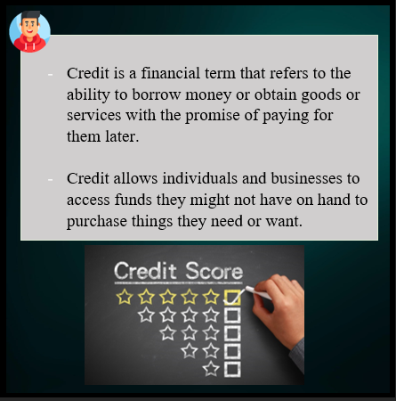
Puzzle 2: Kindly complete the puzzle below and read the statements made by instructor Rudy.

Slide 22
Lesson 2: Kindly complete the puzzle below and read the statements made by instructor Rudy.

Slide 23
Lesson 2: Kindly complete the puzzle below and read the statements made by instructor Rudy.

Slide 24
Lesson 2: Kindly complete the puzzle below and read the statements made by instructor Rudy.

Slide 25
Lesson 2: Congratulations! You can now go to the next page for more lessons.
Next Page
Practice

Slide 26

Practice Tests
What is a credit score? [Easy]
A. Choice A
B. Choice B
C. A credit score is a three-digit number that summarizes a person's credit history and helps lenders determine how likely they are to repay their debts.
D. Choice D
2) What is the ideal credit utilization rate? [Medium]
A. Choice A
B. The ideal credit utilization rate is generally considered to be 30% or less.
C. Choice B
D. Choice D
3) What is the impact of late payments on your credit score, and how can you minimize this impact? [Hard]
A. Choice A
B. Choice B
C. Choice C
D. Late payments can significantly lower your credit score, and minimizing this impact involves making payments on time and contacting your creditors to discuss potential solutions.
Next Page

Slide 27



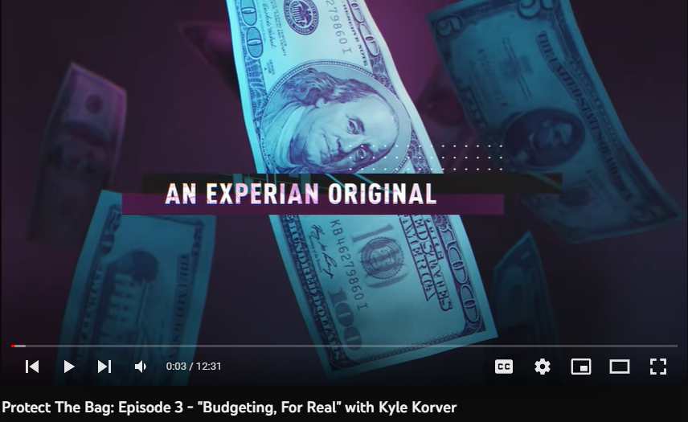
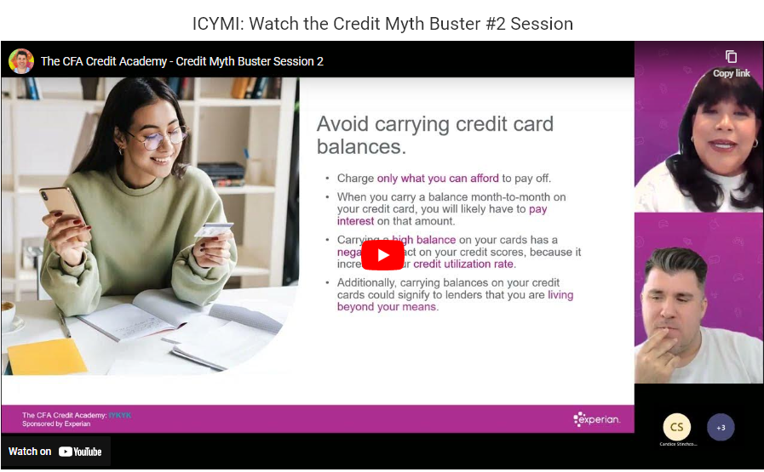
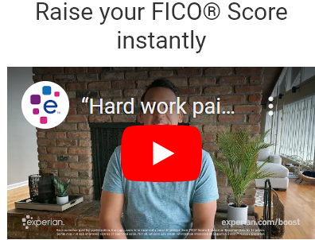

Media/ Calendar
All videos
Calendar and Zoom links

Slide 28

Media/ Calendar
All videos
Calendar and Zoom links
Zoom Meeting link
Credit Academy
Credit Academy
Credit Academy
Zoom Meeting
link
Credit Academy

Slide 29
Certification Test
Christine/ Instructor
Note: In order to take the certification test, you will have to complete all the lessons.
What is contained on the certification test:
50 questions to test your knowledge on credit
15/50 are labeled easy
15/50 are labeled medium
20/50 are labeled hard
What you need to pass and get a certificate:
Obtain at least 80% of the test. If you don’t manage to required grade, you will have unlimited access to both the lessons and different, but similar, types of certification test questions.
Getting a certificate is a great way to show your knowledge of credit, which you can use when applying for a credit card.
Take the test

Slide 30
Certificate Tests
What is a credit report? [Easy]
A. Choice A
B. Choice B
C. A credit report is a document that includes a person's credit history, including their payment history, current and past credit accounts, and any delinquencies or defaults.
D. Choice D
2) What is a credit limit, and how is it determined? [Medium]
A. Choice A
B. A credit limit is the maximum amount of credit that a lender will extend to a borrower. It is determined based on factors such as a person's credit history, income, and debt-to-income ratio.
C. Choice B
D. Choice D
3) How can you manage multiple credit cards to avoid damaging your credit score? [Hard]
A. Choice A
B. Choice B
C. Choice C
D. You can manage multiple credit cards by keeping your credit utilization low, making payments on time, and being mindful of potential fees and interest rates.
Next Page

Slide 31
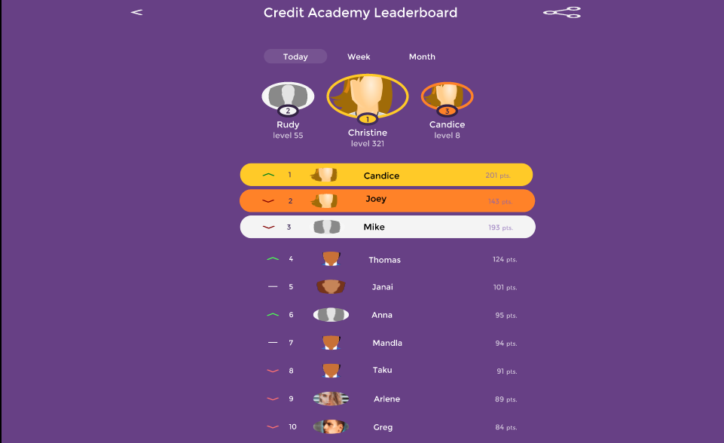

Slide 32



Chat for students
Samuel
Hey Joey, congratulations for making it on the Credit Academy Leaderboard.
Thank you very much Samuel. I appreciated you for reaching out to me. What is your classification?
seen
Text your message

Slide 33
How this program benefits Experian
1) Cost Saving: Incorporating a game in our program reduces the costs associated with customer support and education. Students are more engaged in an interactive learning experience, and they are less likely to need additional support.
2) Positive PR: The leaderboard will keep students engaged and immersed in the program by providing incentive to the final top ten scholars at the end of the program. This will encourage more students to join the credit and learn more about Experian.
3) Additional Information: In addition to our lessons, our program educates students about Experian features such as Experian Boost.

