Slide 1
Small Business and Personal Credit

Slide 2
Introduction
Purpose
Understand the basics of personal and business credit reporting
Recognize the value of having positive personal and business credit histories
Understand how your personal credit can affect your ability to get credit for your business and how your business credit can affect your ability to qualify for personal credit
Learn to manage both your personal and business credit to help your business (and you) succeed

Slide 3
What is a business credit report?
Much like personal consumer credit report
Your financial references, which help potential creditors make decisions about doing business with you
References are provided by those with whom you have established credit relationships, such as:
Suppliers
Wholesalers
Manufacturers
Banks
Leasing companies
Other financial institutions
More than 25 million businesses in the U.S. have established credit relationships

Slide 4
Your business credit report Identifying information/company background
Company name
Key personnel
SIC code
Business type (i.e.. Incorporated, LLC)
Address
Phone number
Date of incorporation
Years in business
Number of employees
Sales

Slide 5
Your Business Credit Report Payment information
Current Days Beyond Terms
Payment Trend Indicator
Lowest 6 month balance
Highest 6 month balance
Current total account balance
Highest credit amount extended
Median credit amount extended
Individual account information
Inquiries
Public records

Slide 6
Your business credit score
Like personal credit reports, your business credit report is often scored to help evaluate risk and streamline the application process
Can be purchased with the business credit report
Experian’s reports are scored by Business Reports Intelliscore Plus:
0 - 100 scale
Higher score = lower risk
Risk factors describe what is negatively impacting the score

Slide 7
How do you establish a business credit report?
Ensure creditors and suppliers can validate your business information:
Incorporate or form an LLC (Limited Liability Company)
Obtain a federal Employer Identification Number
Open business bank accounts in your legal business name
Set up a dedicated business phone line and make sure it's listed
Establish credit with companies who report trade and payment information

Slide 8
How can I obtain my small business credit report?
Order a copy of your business credit report at one of two websites:
www.smartbusinessreports.com
www.experian.com/businesscreditreport
If you have been declined credit within the last 60 days based on information provided in your Experian business report, you may get a free copy by contacting Experian Commercial Relations at (888) 211-0728.
You may purchase a scored report.

Slide 9
How can you monitor your own business credit report?
Check your business credit report frequently to ensure that the information is accurate and up-to-date.
Order a one-time report from Experian, or sign up for business credit monitoring service called Business Credit Advantage, which provides:
Unlimited access to your report and score
Email notification of changes to your business credit file
Early warning of negative changes or business identity theft

Slide 10
Are your business credit report and your personal credit report linked?
No. But they can be related. . .
. . .if you secure business debt with personal credit.

Slide 11
The role of personal reports in business credit
The Fair Credit Reporting Act (FCRA) allows lenders to review for business lending purposes the personal credit histories of:
a proprietor of an unincorporated business
a partner in a partnership
a guarantor of a business loan
Personal credit information must be used solely for a business credit transaction
Securing business debt with personal credit makes you personally responsible and gives lenders the right to report the account and any missed payments in both your personal and business credit reports.
Your personal credit report and your business credit report may be scored by using one of hundreds of scoring models available to lenders that help them evaluate risk.

Slide 12
How can your business and personal credit reports be used together to benefit your business?
More than 90% of U.S. businesses are small
Fewer than 25 employees
Less than $20 million in annual revenues
Small businesses may have little or no credit history upon which to base a decision
Half of all owners use some form of personal credit to finance their small businesses
Personal credit history acts as a “reference” for entrepreneurs. Once established, your business credit report can influence:
Suppliers’ willingness to extend credit
The loan amount and terms
Business insurance premiums

Slide 13
What happens if I feel information on my Experian business report is wrong?
First, obtain a copy of your business credit report at www.experian.com/businesscreditreport or www.smartbusinessreports.com
Incorrect demographic information can be updated at www.businesscreditfacts.com.
All other disputes must be submitted in writing. Instructions are provided with your report.
This dispute resolution process typically takes less than 30 days
Monitor your business credit report for changes over time
To speak with a representative, contact Experian’s business credit helpdesk at 800-303-1640.
.

Slide 14
How does the dispute process work for my personal credit report?
Obtain a copy of your personal credit report directly from Experian
One report free every 12 months at www.annualcreditreport.com
Follow instructions from lender if adverse action is taken
Subscribe to monitoring service or purchase an individual report at www.experian.com
Credit reporting company verifies with the source of the information (creditor or court)
Must allow 30 - 45 days for processing
Source verifies, corrects or updates
Secure electronic mail system is used
Creditors required to report corrections to all databases
You can add a “statement of dispute” if you disagree with the results of the dispute

Slide 15
How long is information kept on my business credit report?
Experian uses standard industry and government guidelines for keeping data on file. Expiration dates for data ensures that the information presented in a report is current enough to create an accurate picture of financial health.
Trade Data: 3 years
Bankruptcies: 10 years
Judgments: 7 years
Tax liens: 7 years
UCC filings: 5 years
Collections: 7 years
Bank, Government & Leasing: 3 years

Slide 16
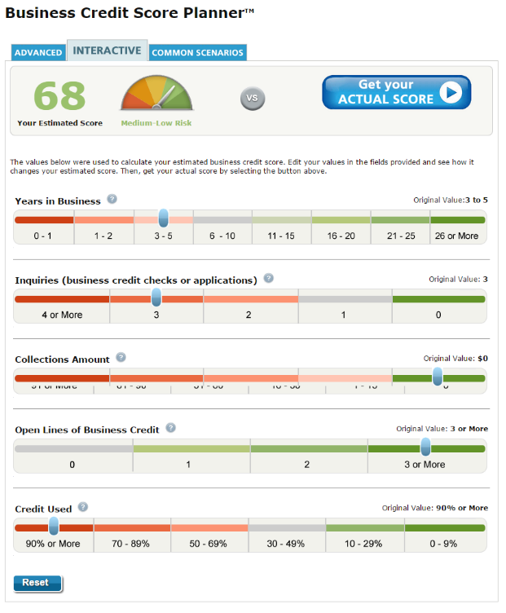
Resources
The Score Planner Tool can be used to develop a strategy to enhance your business credit score and increase your company’s access to capital
Experian Business Credit Reports www.experian.com/businesscreditreport
FACTA Free Credit Report www.annualcreditreport.com
Experian Credit Education www.experian.com/credit-education
Ask Experian www.experian.com/blogs/ask-experian/
BusinessCreditFacts.com http://www.businesscreditfacts.com/
Experian Business Score Planner http://sbcr.experian.com/scoreplanner
Notes:
16

Slide 17
In conclusion
Grow your business with good credit practices
Maintain a distinctly separate business credit profile
Stay current on payments to creditors
Ensure that your good payment history is reported to the credit bureaus
Monitor your business credit profile to detect issues or fraud
Use business credit reports to limit your risk of doing business with others

